Slide 1
Lecture – 10

Slide 2
n−1
P =
∑
i
2 x Y
i=0
i
Combinational Array Multiplier
Composed of arrays of simple combinational elements, each of which implements an add/sub and shift operation for small slices of the multiplicand operands.
X = x_{n−1}x_{n−2}.........x₁x₀ and Y = y_{n−1}y_{n−2}.........y₁y₀ where both X and Y are unsigned integers. Now P = X ×Y can
be expressed as
n−1
P =
∑
i
2 x Y
i
n−1 ⎛ n−1
i =0
which can be rewritten as
⎞
P =
∑
2
i
⎜
∑
x_{i} y _{j} 2
j
⎟
i =0 ⎝ i =0 ⎠
It requires n × n array of 2-input AND gate.
The product terms are summed by an array of n(n-1) 1- bit full adders.

Slide 3
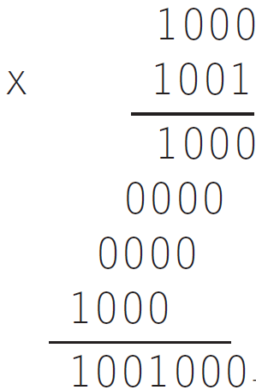
Multiplication
Multiplicand Y
Multiplier X = x x x x
If multiplicand = n bits and multiplier = m bits then product = n + m bits.
3 2 1 0
Two rules:
Place a copy of multiplicand in the proper place if multiplier bit=1.
Place 0 in the proper place if multiplier bit = 0.
3
Product
P =
∑
j =0
j
x 2 Y
j
P = P + x 2^{i} Y
i +1 i j

Slide 4
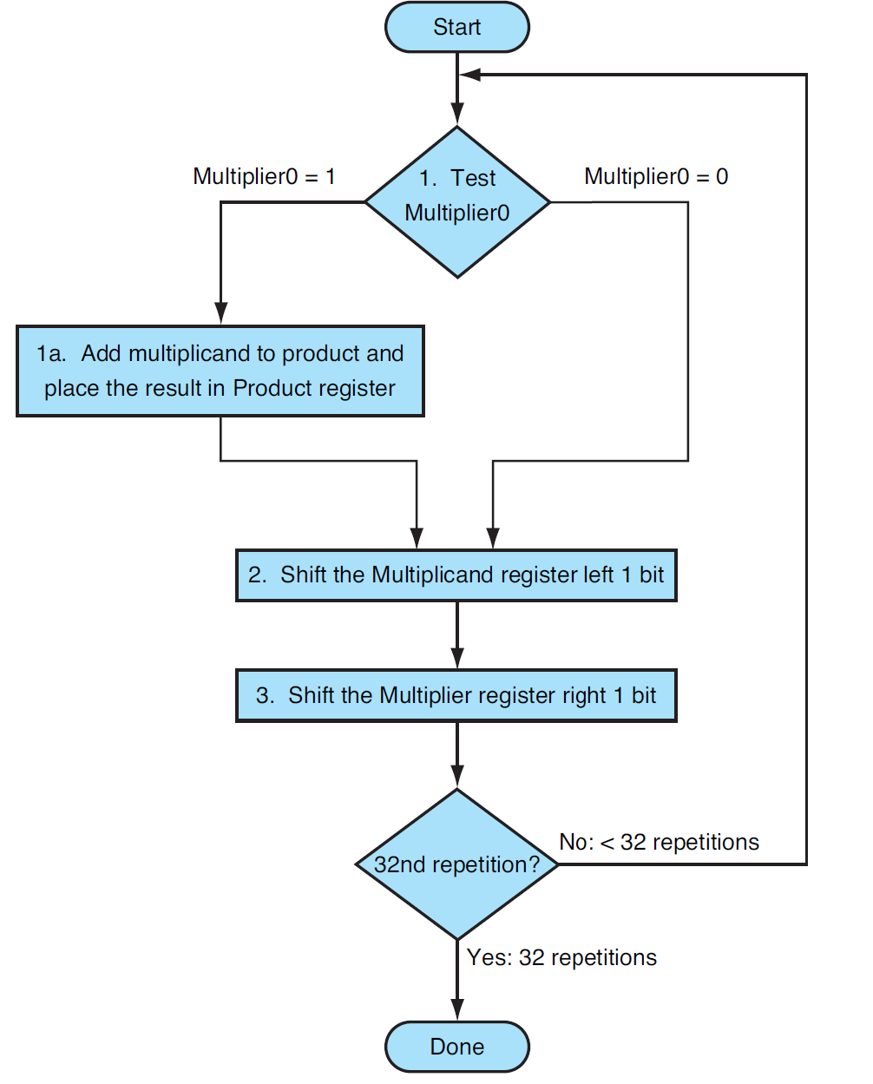
Sequential Multiplication Algorithm

Slide 5
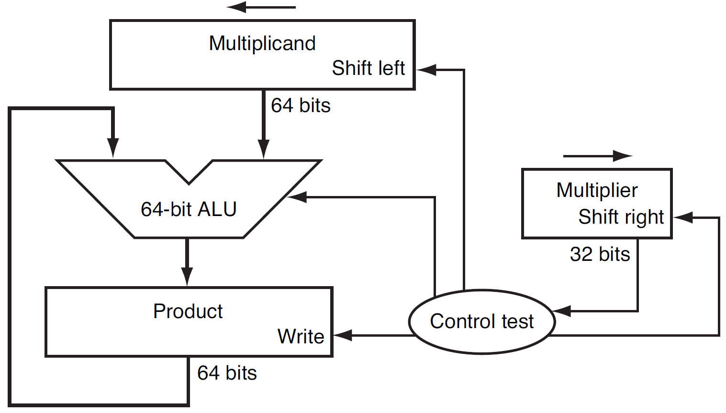
Sequential Multiplication Hardware

Slide 6
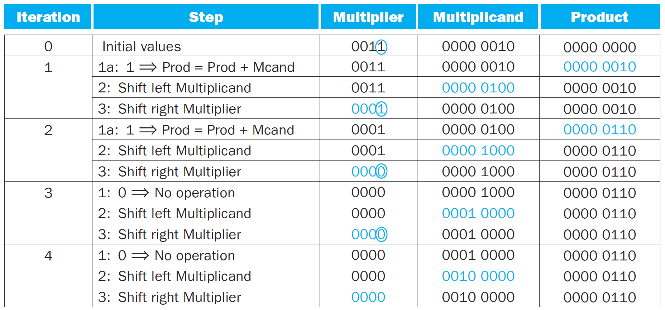
Sequential Multiplication Example

Slide 7
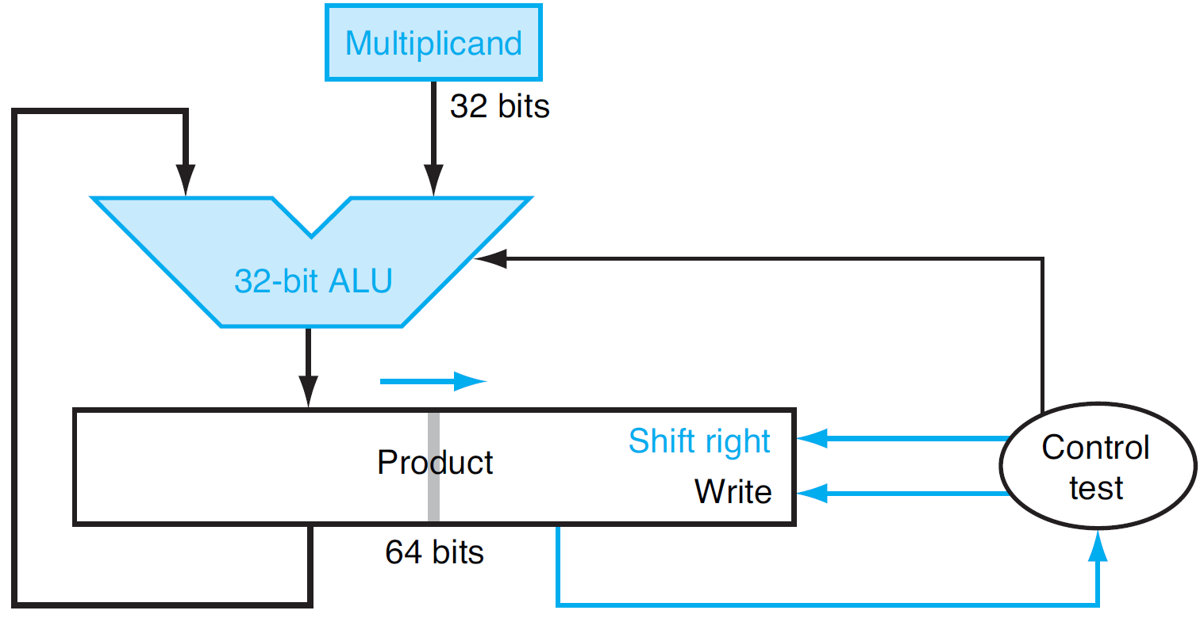
Refined Version of Multiplication Hardware

Slide 8
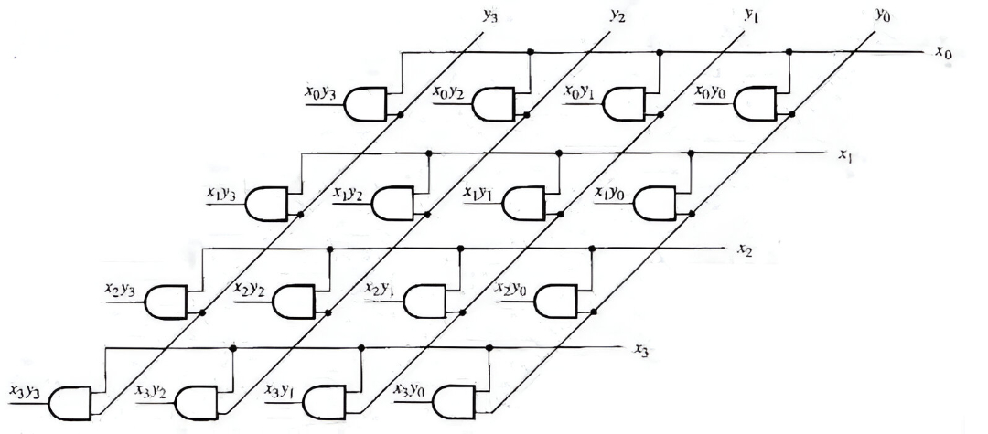
AND Array for 4 X 4 bit Unsigned Multiplication

Slide 9
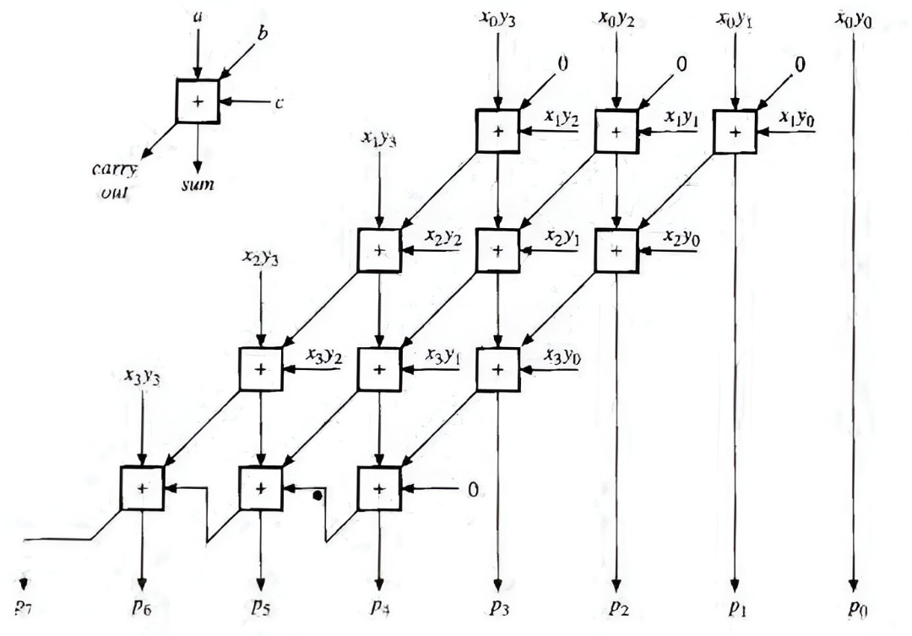
Full Adder Array for 4 X 4 bit Unsigned Multiplication

Slide 10
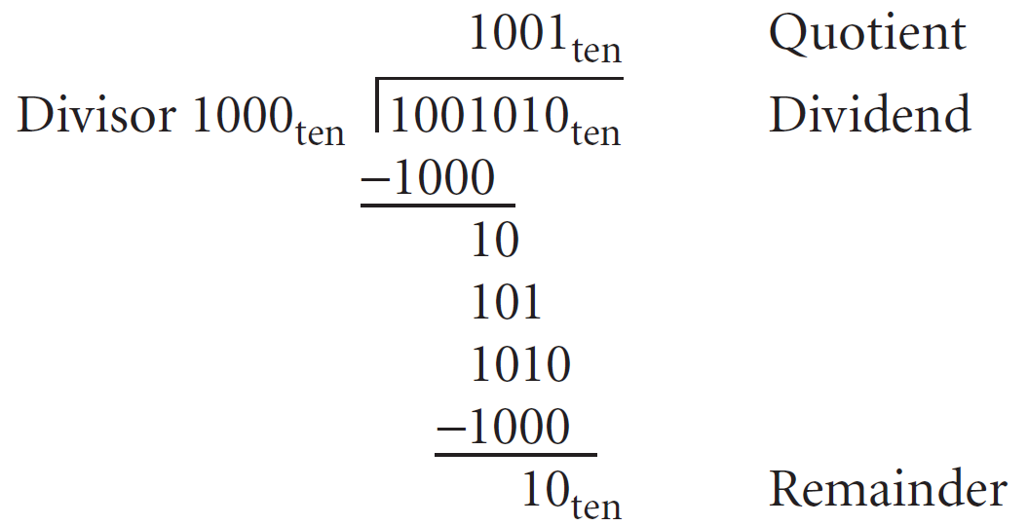
Division

Slide 11
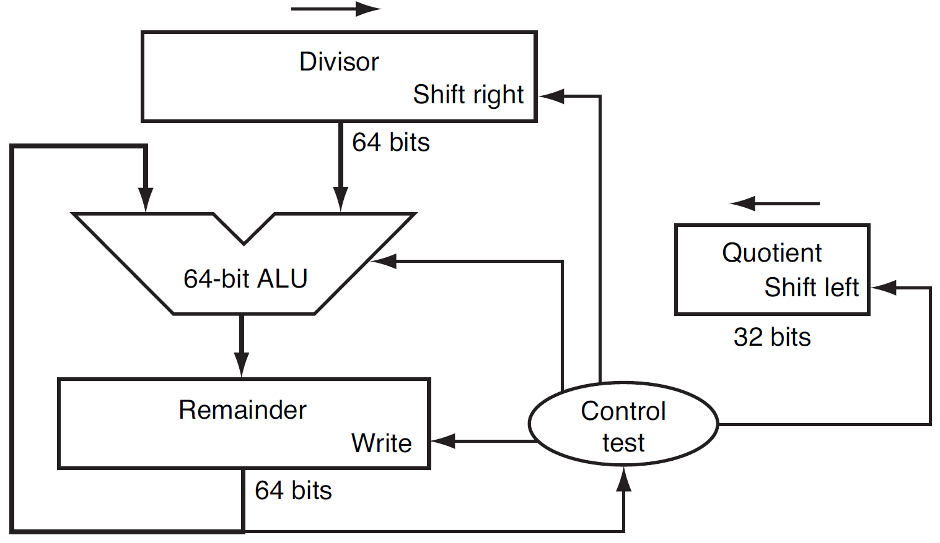
Division Hardware

Slide 12
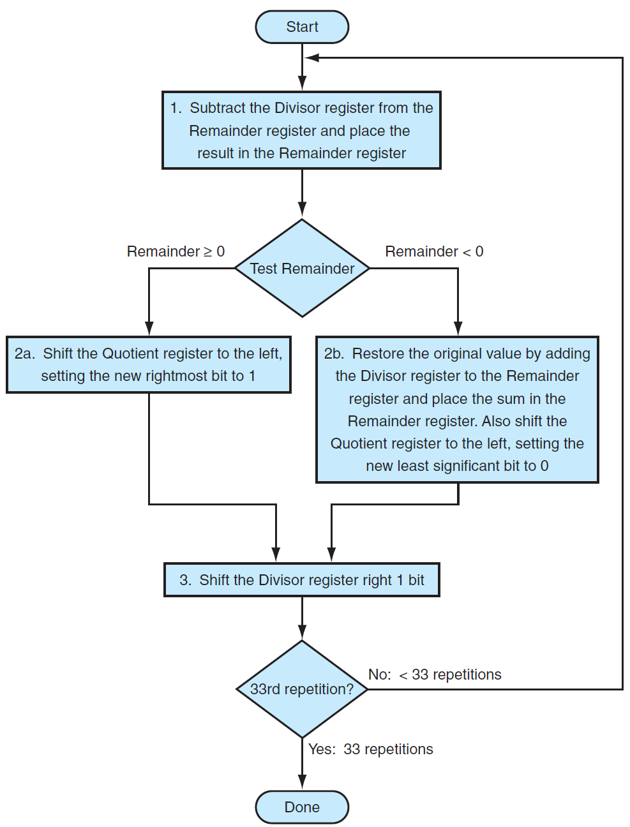
Division Algorithm

Slide 13
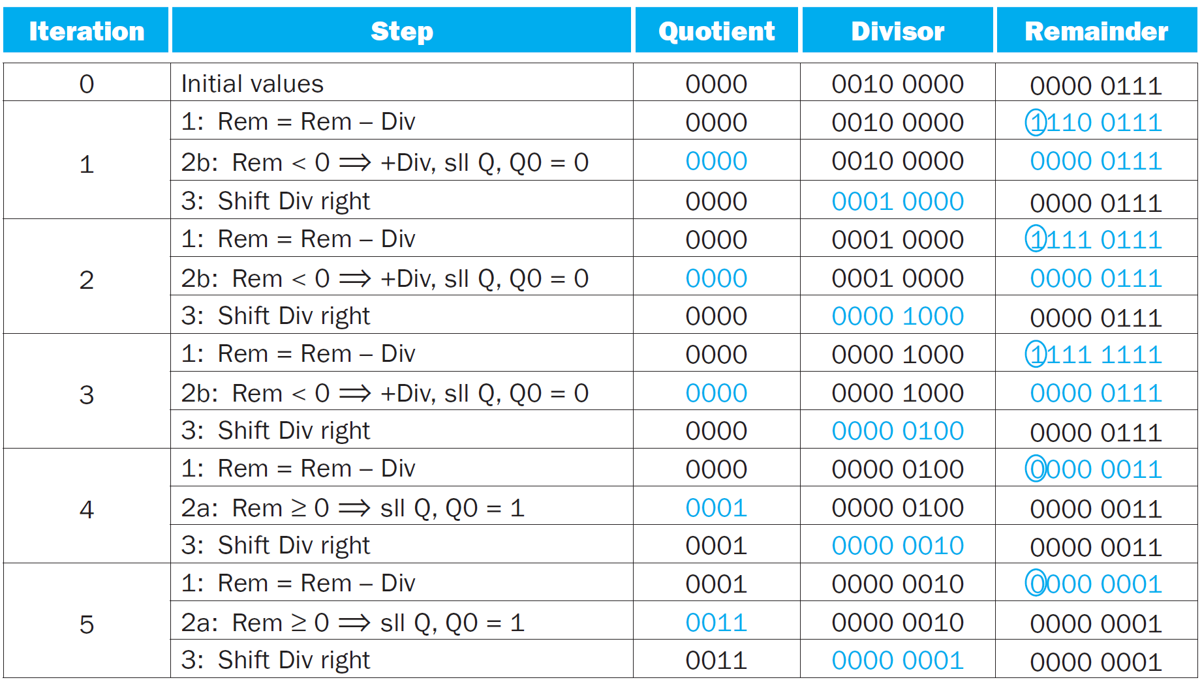
Division Example

